Slide 1

Putting structured data into individual entry pages in biological database
BioHackathon 2018 - Paris
http://bh2018paris.info/
Proponent: Jun-ichi Onami, Tatsuya Kushida, Shigeru Yatsuzuka
National Bioscience Database Center (NBDC)
JAPAN SCIENCE AND TECHNOLOGY AGENCY (JST)
Project links
https://github.com/elixir-europe/BioHackathon/tree/master/interoperability/Putting%20structured%20data%20into%20individual%20entry%20pages%20in%20biological%20databasehttp://github.io/your_repo

Slide 2
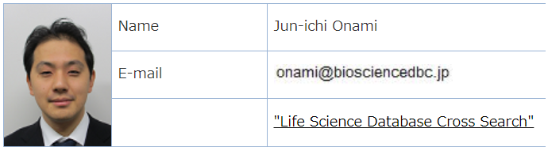
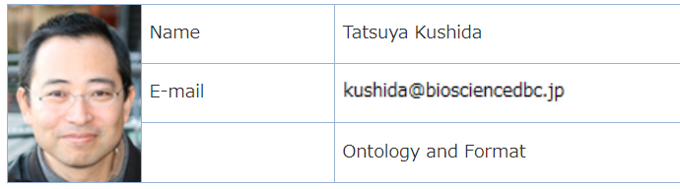
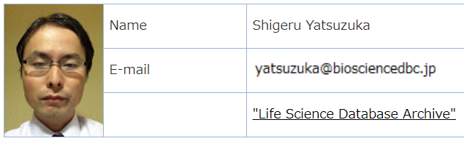
from tomorrow

Slide 3
Background information

Slide 4
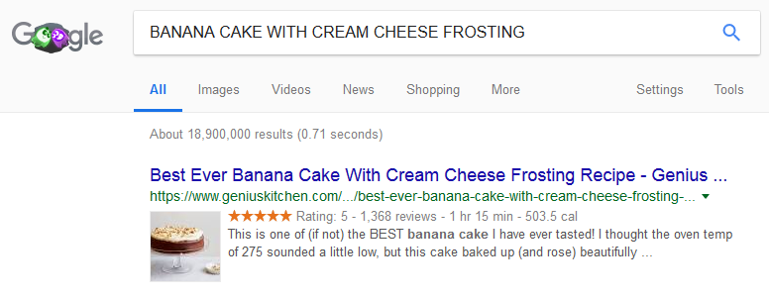
When you want to search the recipe of BANANA CAKE…
thumbnail image
reviews number
nutrition calories
Rating info
Cook time
These snippet information are useful to find good recipe data.

Slide 5
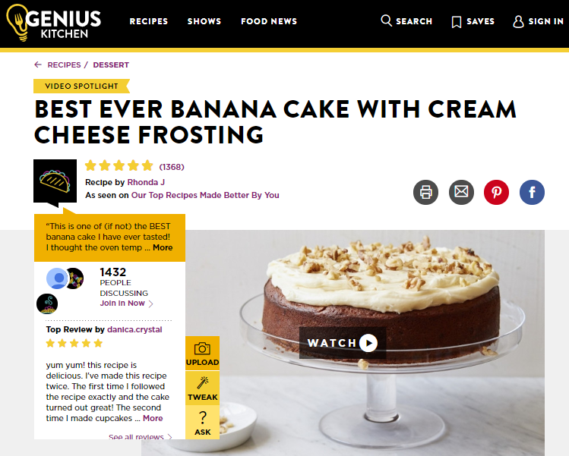
Inserted structured data into html source (=markup)
***HTML SOURCE***
<script type="application/ld+json">
{"@context":"http://schema.org",
...........................
"totalTime":"PT1H15M",
"aggregateRating":{"@type":"AggregateRating",
"ratingValue":"5.0","reviewCount":"1368"},
"nutrition":{"@type":"NutritionInformation",
"calories":"503.5",......................................},
"thumbnailUrl":"https://images.video.snidigital.com/ image/upload/w_1024,h_576,c_fit/prod/genius/sni1 uss-aakamaihdnetScripps_- _Genius_Kitchen129781170925_4179510_Best_E ver_Banana_Cake_1517343623jpg.jpg",
...........................
}
</script>
https://www.geniuskitchen.com/recipe/best-ever-banana-cake-with-cream-cheese-frosting-67256
Is it a Piece of Cake?
How to use markup schema?

Slide 6
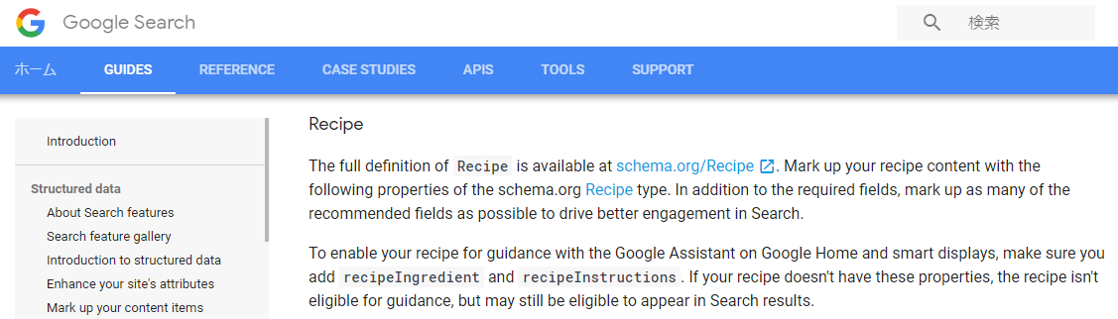
There is a guideline for the Recipe data markup.
https://developers.google.com/search/docs/data-types/recipe#guidelines
based on schema.org/Recipe
not all schema data are reflected

Slide 7

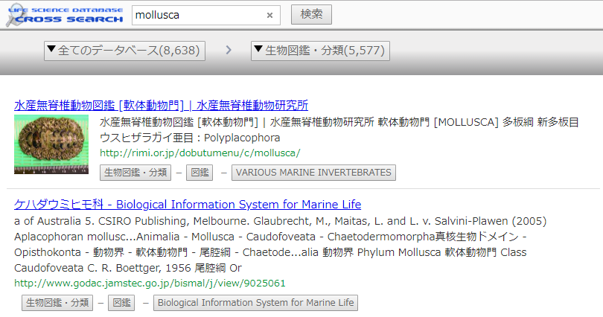
Web page with markup schema
provide
structured data
provide
semantic data
advanced data user
(informatician)
schema based
search engine
* easy integration
* accurate analysis
* provide rich data

Slide 8
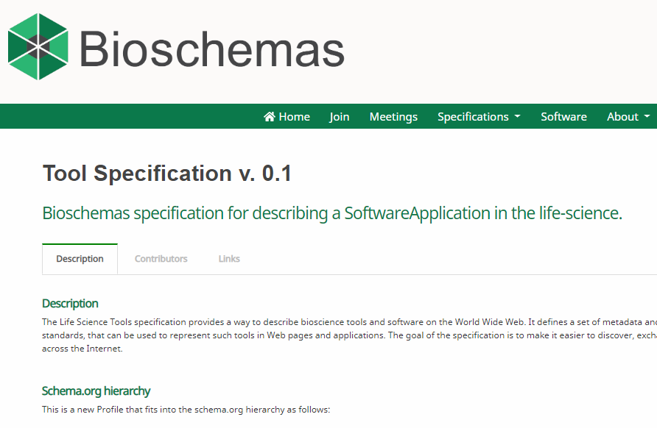
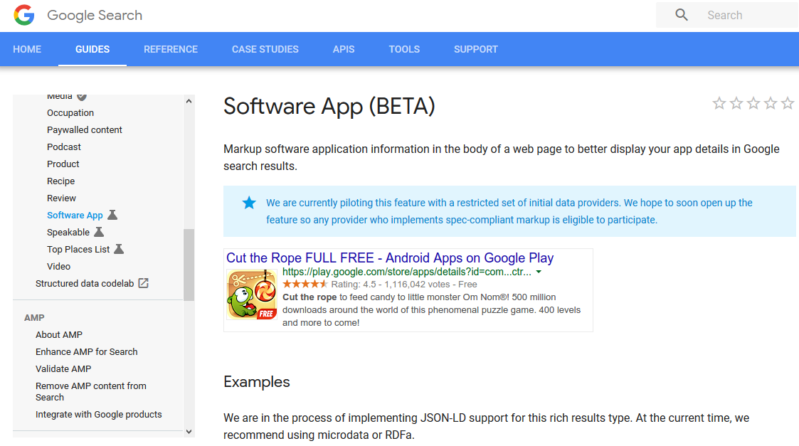
How about in biological field?
https://developers.google.com/search/docs/data-types/recipe#guidelines
http://bioschemas.org/specifications/Tool/
Some markup schema standards for application tools are establishing

Slide 9
Goal
We will try to markup the web page of biological tools.
Discuss about the markup methods and schema for biological tools.

Slide 10
Hacking schedule
13rd. Nov. Discussion about schema for biological tools
14th. Nov. Discussion and scripting
15th. Nov. Scripting and markup program execution
16th. Nov. Review

Slide 11
Post-biohackathon perspectives
Putting constructed data into some public databases
Optimizing our our Life Science Cross Search to discussed schema
➔ Find the best practice to put good schema markup into biological database web page

Slide 12
Contact and links
Contact (s)
Jun-ichi Onami (onami@biosciencedbc.jp)
Tatsuya Kushida (kushida@biosciencedbc.jp)
Shigeru Yatsuzuka (yatsuzuka@biosciencedbc.jp)
Links related to the project
Life Science Cross search
https://biosciencedbc.jp/dbsearch/index.php?lang=en

Slide 13
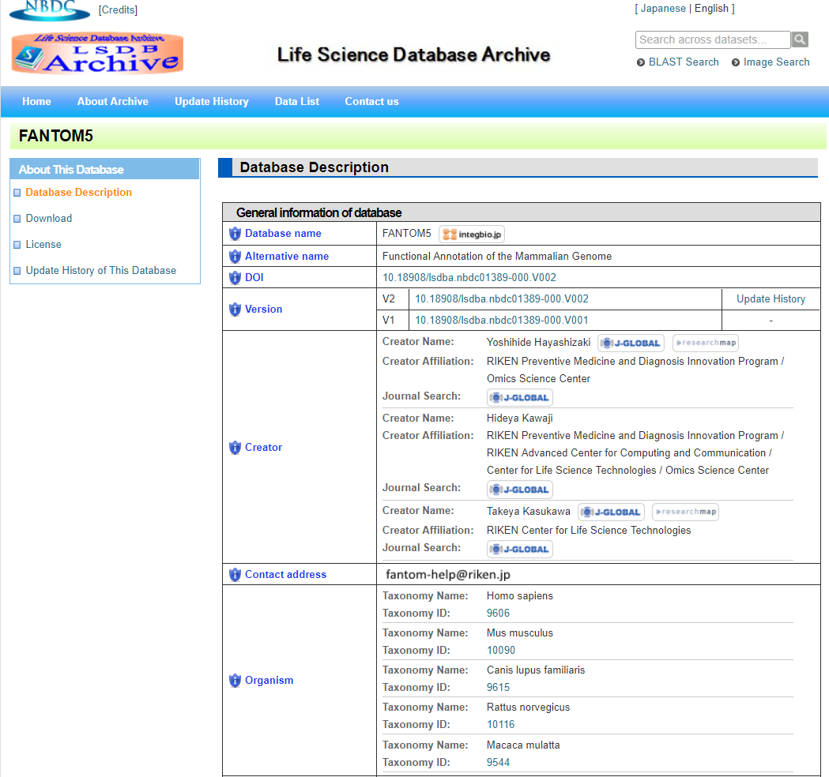
+α Database (archive) page example: FANTOM5

Slide 14
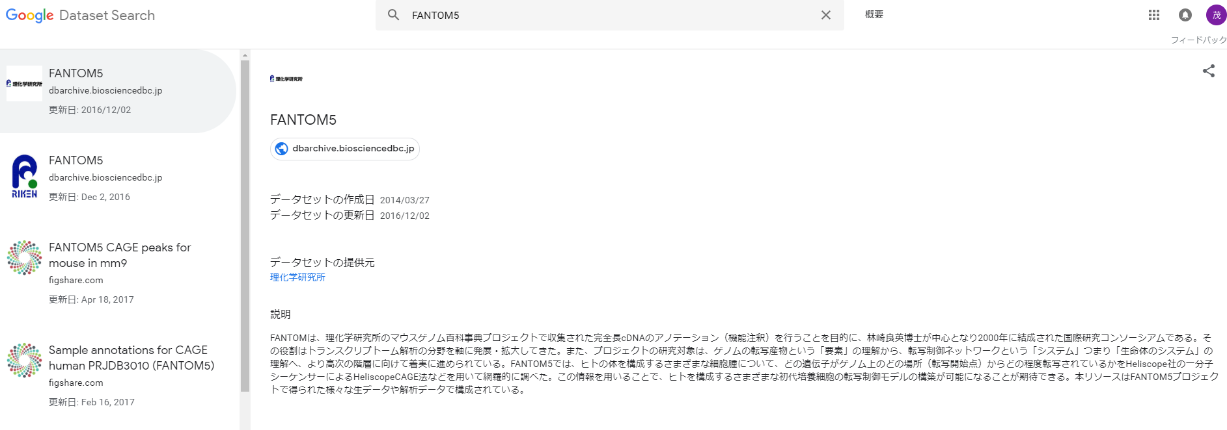
+α Google Dataset Search result

Slide 15
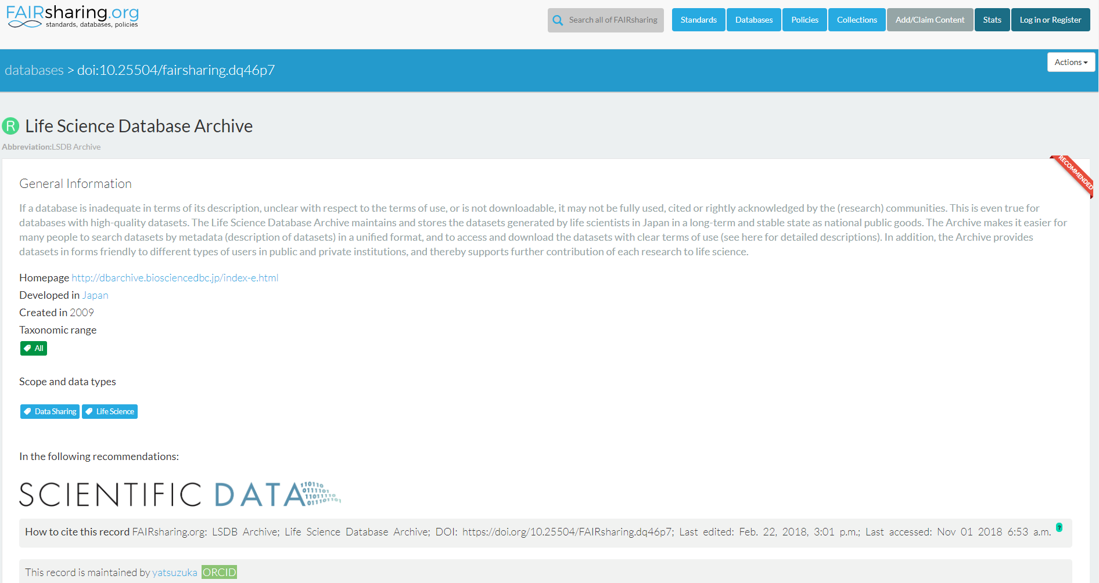
+α Example of FAIRsharing
{
"@context": "http://schema.org",
"@id": "https://doi.org/10.25504/FAIRsharing.dq46p7",
"@type": "Dataset",
"alternateName": "LSDB Archive",
"citation": {
"@type": "CreativeWork",
"identifier": "doi:10.25504/FAIRsharing.dq46p7"
},
"datePublished": "2016-08-17 03:47:58",
"description": "If a database is …",
"identifier": "10.25504/FAIRsharing.dq46p7",
"license": "https://creativecommons.org/licenses/by-sa/4.0/. ...",
"name": "Life Science Database Archive",
"url": "https://doi.org/10.25504/FAIRsharing.dq46p7"
}

Slide 16
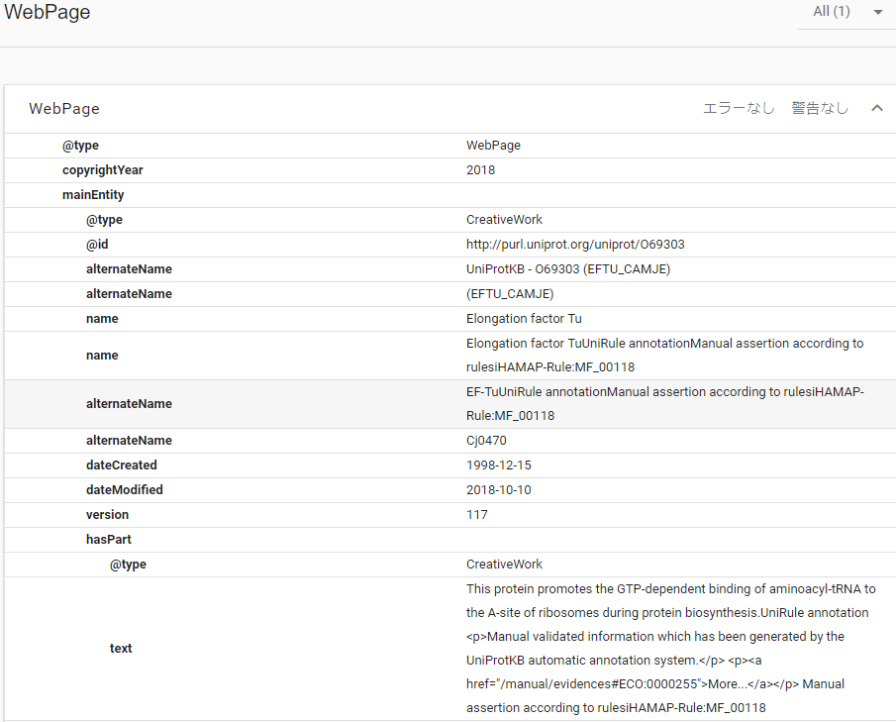
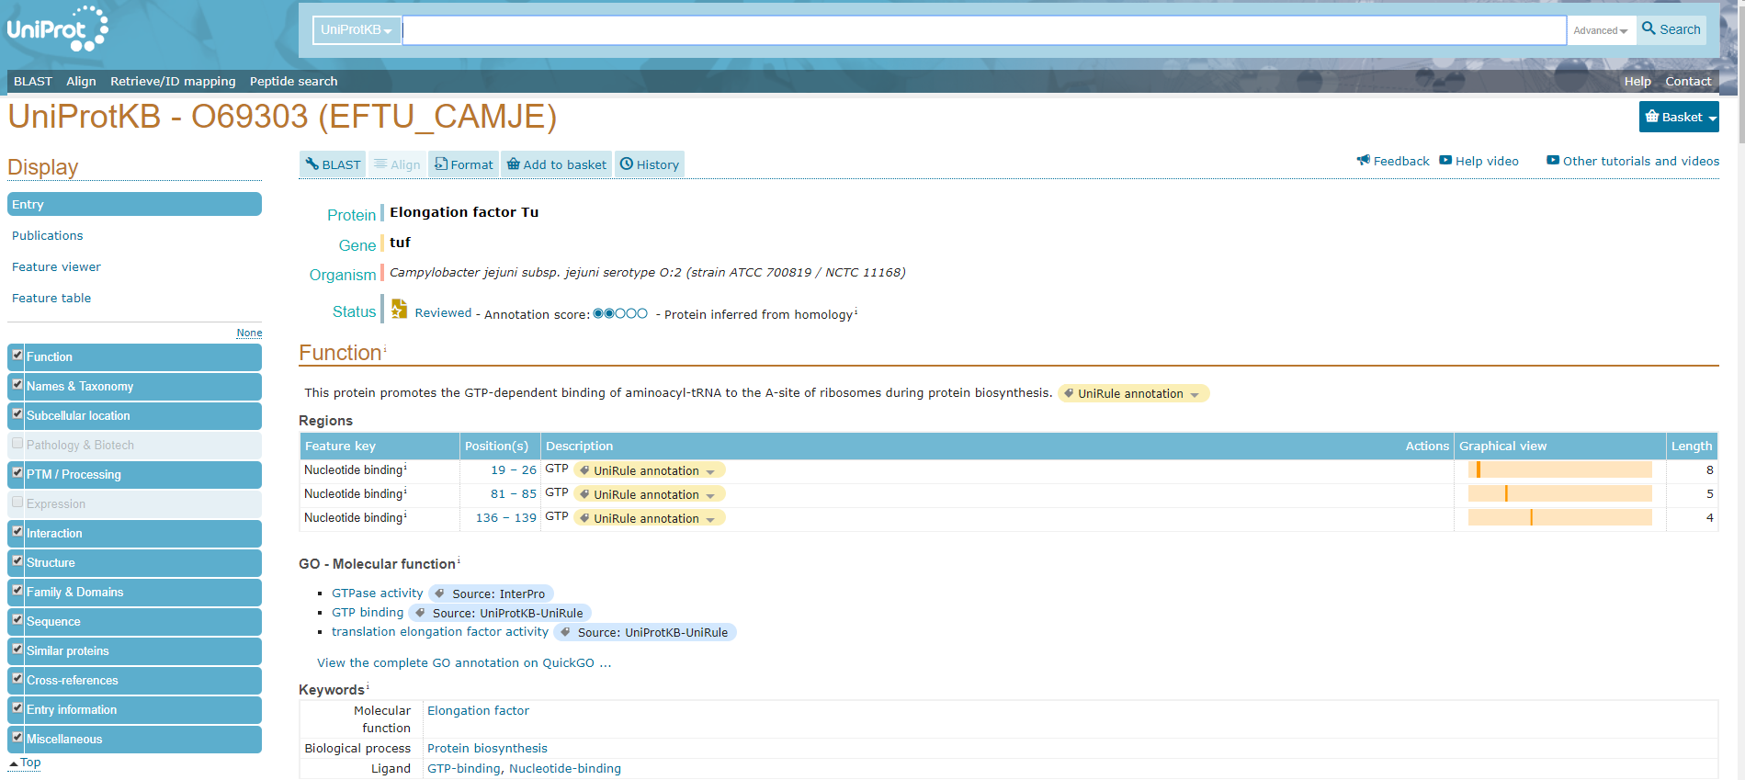
+α Example of UniProt

